Slide 1


Slide 2


Slide 3
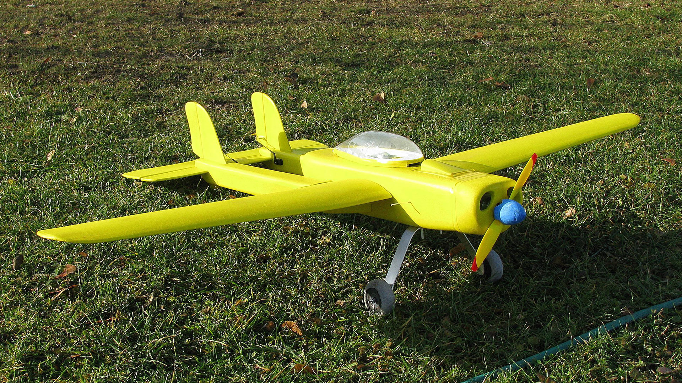

Slide 4


Slide 5


Slide 6


Slide 8
The PowerPoint slides for the
Younger Adaptation are found below.
If you are choosing to use the
Younger Adaptation portion of the lesson,
be sure to modify the PowerPoint to
include the Younger Adaptation visuals.

Slide 9
Video 1

Slide 10
The additional slides below are
provided so the PowerPoint can be adapted to best fit your needs.

Slide 11


Slide 12


